Slide 1
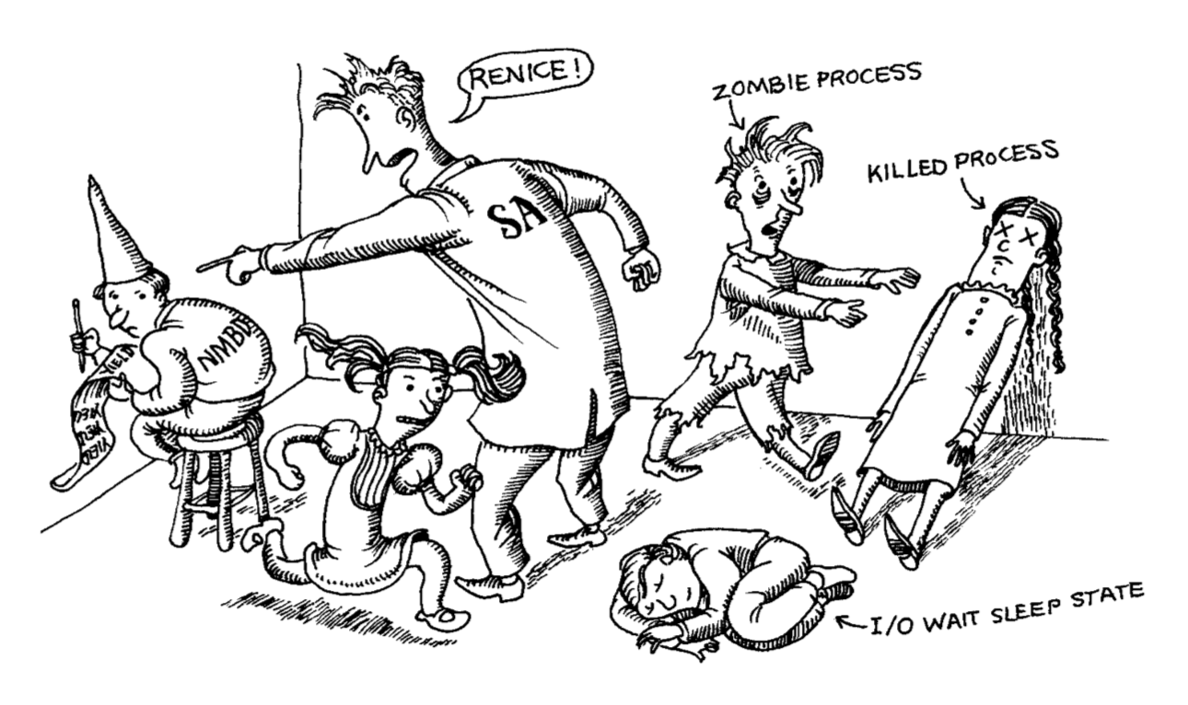
Process Control

Slide 2
What is a Process?
A process represents a running program. It’s the abstraction through which memory, processor time, and I/O resources can be managed and monitored
UNIX philosophy states that as much work as possible should be done with processes rather than being handled specially by the kernel
System and user processes follow the same rules, so you can use a single set of tools to control them

Slide 3
Process Bookkeeping
The kernel tracks several pieces of information for each process:
Address Space Map
Current Status
Execution Priority
Resource Usage
Files and Network Ports used
Signal Mask (which signals are blocked)
Owner
As well as lots of other pieces of information

Slide 4
Processes vs. Threads
Processes represent programs which the kernel coordinates
Process has memory allocated to it by the kernel which contains: code, libraries, variables, process stack, and bookkeeping information
Threads are an execution context within a process
There is at least one thread associated with every process, but there can be more (multithreaded programs)
Threads have their own stack and CPU context, but use the processes memory

Slide 5
Important Process Information
PID: Process ID Number
Unique ID number assigned to the process by the kernel
Most commands require PID to specify which process to effect
Low PIDs are typically special system processes (PID1 is systemd/init)
PPID: Parent PID
There is no method to create new processes directly in UNIX (systemd/init is a special case)
Instead, all processes are forks of another process with their execution replacing the parents
PPID allows you to track where a process spawned from
Notes:
The method for creating new processes from existing ones is exactly what the CS 100 project requires as of Spring 2019

Slide 6
Important Process Information
UID and EUID: real and effective user ID
Process UID is the user identification number of the user who created it
In reality it is a copy of the UID value of the parent process (since that is how it is created)
EUID is the “effective” UID and determines what resources and files a process can access
EUID describes permissions rather than identity, allowing processes to gain and lose privileges through the use of setuid
Control Terminal
Displays which terminal the process is connected to for standard input, output, and error printing
Notes:
The kernel maintains a copy of the EUID that is used when the process is created which can be used to allow conservative programs to only switch to extra privilege mode when necessary

Slide 7
Important Process Information
GID and EGID: real and effective group ID
Functions the same as UID and EUID but for group identity and permissions
Since users can belong to multiple groups, access permissions are determined using the EGID and a supplemental group list
Niceness
Measurement of priority for a process which is combined with how much CPU time the process has used and how long its been waiting to determine what should be executed when
Low niceness value means it has high priority (it doesn’t plan on being very nice to other processes)

Slide 8
Kernel
systemd/init
fork
systemd/init (copy)
systemd/init (original)
exec
wait
new process
termination
Notes:
Initially the kernel spawns the systemd/init original process with PID 1, UID 0, and GID 0 as a special case. From here all other processes are spawned from this process or another process already spawned off of systemd/init. This process happens when a fork is called on systemd/init or another process which creates two copies: the original execution (parent) and the new clone (child). The child then calls one of the exec functions to replace its currently executing code with the new process that it wants to execute. Meanwhile the parent should have some mechanism to wait for the completion of this (and any other) child processes that it has forked before completing. When a forked process terminates using an _exit command (or terminates for some other reason) the exit code is sent to the kernel and reported to the parent process to review. If the parent process dies before a forked child process then the parent process is switched to systemd/init and it deals with the exit reporting instead.

Slide 9
Process Generation
What are three ways (that you’ve learned so far) that can cause processes to be spawned and executed?

Slide 10
Periodic Processes
There are 3 primary ways that we have learned processes can be executed
Executed by systemd/init during boot
Executed as a subprocess of a boot process
Executed explicitly by a user
However, there are two additional ways that processes can spawn which may be less obvious
The cron (crond on CentOS) process scheduling system
Systemd timers for scheduling processes
These systems are used to schedule tasks that happen at regular intervals such as sending mail reports, cleaning filesystems, rotating log files, processing batch jobs, or backing up the system

Slide 11
cron and crontab
Traditional tool for running commands on a predetermined schedule in Linux
Uses a configuration file called a crontab (cron table) to specify what command should be run when
There is one crontab per user, located at /var/spool/cron as well as system level crontab files at /etc/crontab (for user administrator use) and /etc/cron.d (for software package use)
Cron works silently, but most versions can keep a log file (usually located at /var/log/cron)
crontab informs cron about new configurations and allows you to edit and view crontab files
As root, you can specify a filename or username to most crontab commands to view and edit other users cron tasks

Slide 12
systemd timers
systemd version of scheduled tasks, more powerful than cron but more difficult to set up and manage
Many systems continue to use cron for legacy reasons in addition to systemd timers, with no particular though given to which is used for what
Timers are still systemd units and follow that general structure but require two files: a timer which describes what to activate and a service which specifies what to run when the timer triggers
systemd timers can be administered with systemctl like all other units
systemd timers can also be specifically executed with the systemd-run command, which is convenient for debugging misbehaving processes

Slide 13
Tracking, Diagnosing, and Modifying Processes

Slide 14
Signals
Signals can be used in a variety of different ways
Communication between processes
Sent by the terminal to kill, interrupt, or suspend a process
Sent directly to a process using kill
Sent by the kernel because of an infraction (segfault)
Sent by the kernel for coordination (death of a child process, data on an I/O channel)

Slide 15
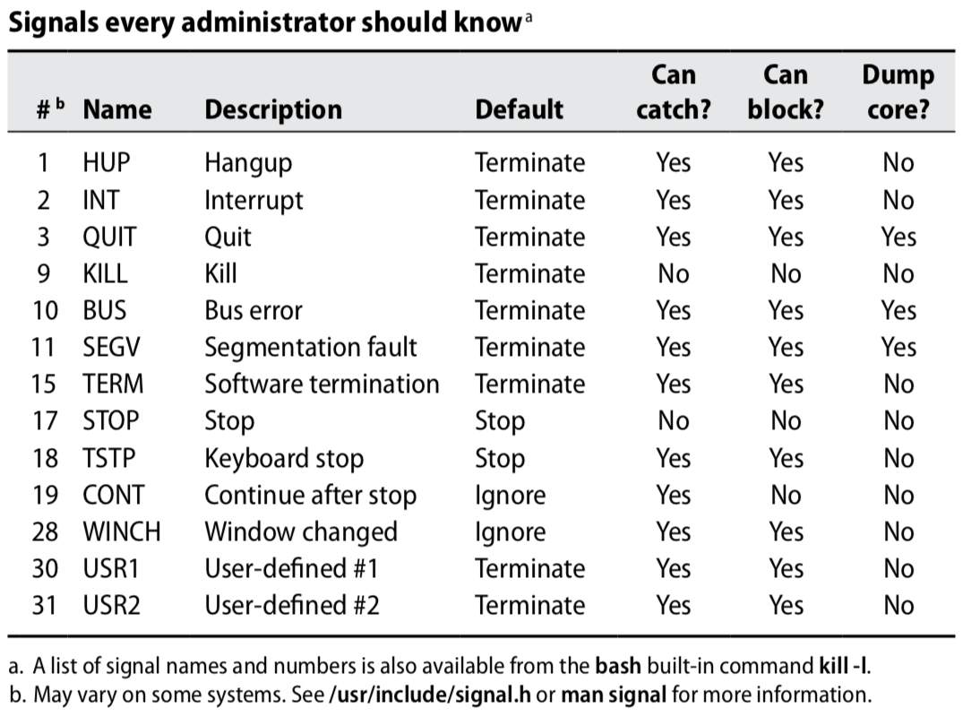
Important Signals
Notes:
BUS and SEGV are the most common error signals which cause programs to crash
KILL destroys the process that its sent to (with extreme prejudice). This is often sent using kill -9 to misbehaving processes
STOP suspends the execution of a process until a CONT signal is sent
INT is sent by the terminal when the user presses <Control-C>. It is a request to terminate which should quit normal processes or they should allow themselves to be killed. Terminals should clean up and then wait for more user input
TERM is a software signal sent to terminate a process, the receiving process should clean up and exit
HUP is read as a reset to many daemons, which will re-read their configuration and restart. It is also generated by terminal driver in an attempt to softly kill an attached process
QUIT is the same as TERM except it generates a core dump; some processes override this behavior to make it mean something completely different

Slide 16
kill Command
Three versions, all used to send signals (TERM by default) to processes
kill [-signal] pid sends the specified signal to the process specified by the given pid
killall [-signal] pname sends the specified signal to all processes matching the process name pname
pkill [-signal] [-P ppid] [-u euid] [-U uuid] sends the specified signal to all processes matching the criteria, and allows you to specify a large set of search criteria

Slide 17
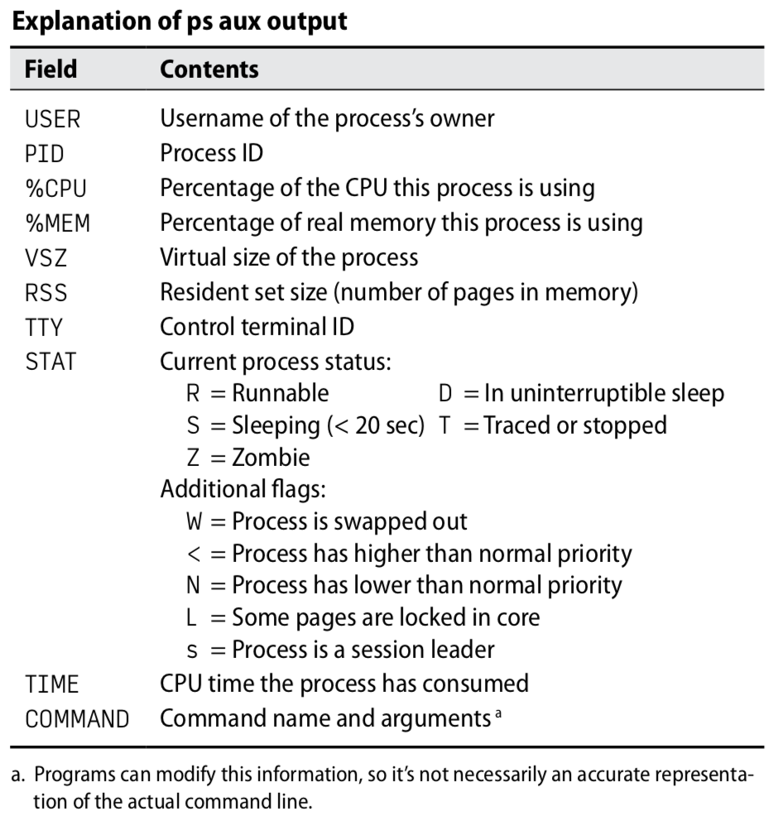
ps Command
Allows you to view process information, exact commands and how they are displayed vary by distribution
Primary commands are ps aux (user friendly print) and ps lax (more technical)
Pipe the output of ps to grep in order to search for particular processes
ps aux | grep sshd

Slide 18
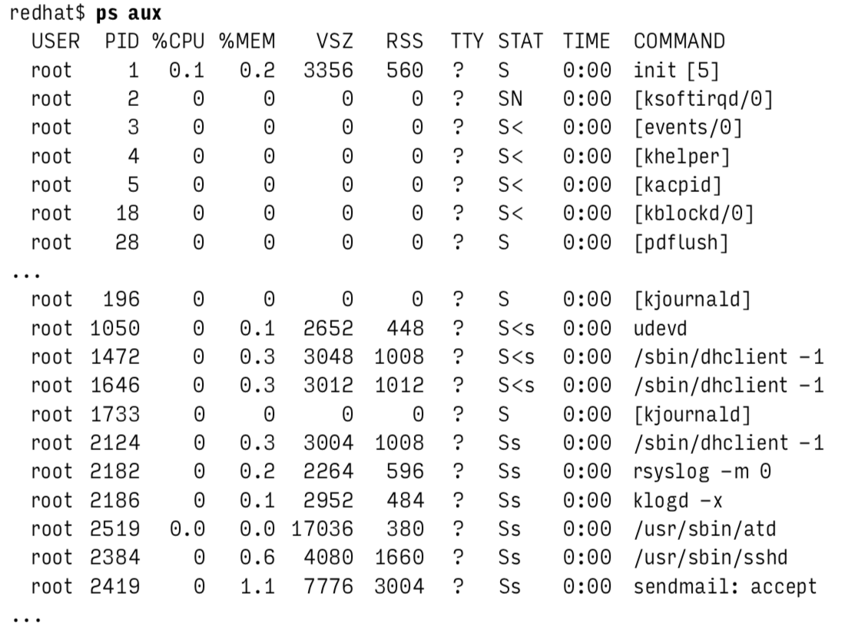
ps aux

Slide 19
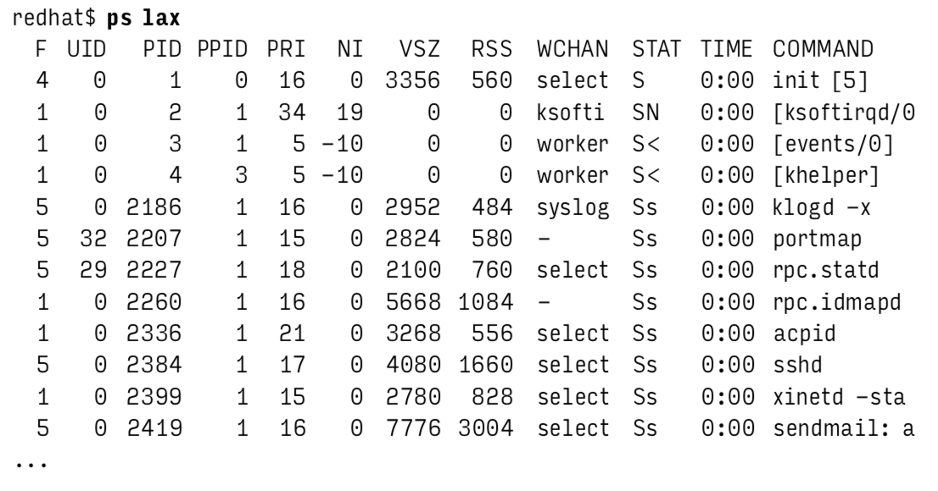
ps lax
Notes:
WCHAN is the kernel function where the process is sleeping

Slide 20
top Command and nice/renice
While ps gives you a snapshot of the process information, top gives you an interactive display which updates every 1-2 seconds (configurable) and displays both per-process information and overall system usage
This can be very useful for finding runaway processes (as can ps if they are non-transient) but you should be cautious as runaway processes and processes under heavy load can look similar in ps and top
top also allows you to view utilization on average and for each specific core, as well as renice processes to change their priority and track the results
renice (+/-) X allows you to increase or decrease the priority (niceness) of a process by a value X (-20 to 19 range). This is rarely done by hand, but might be useful for services which are expected to respond quickly

Slide 21
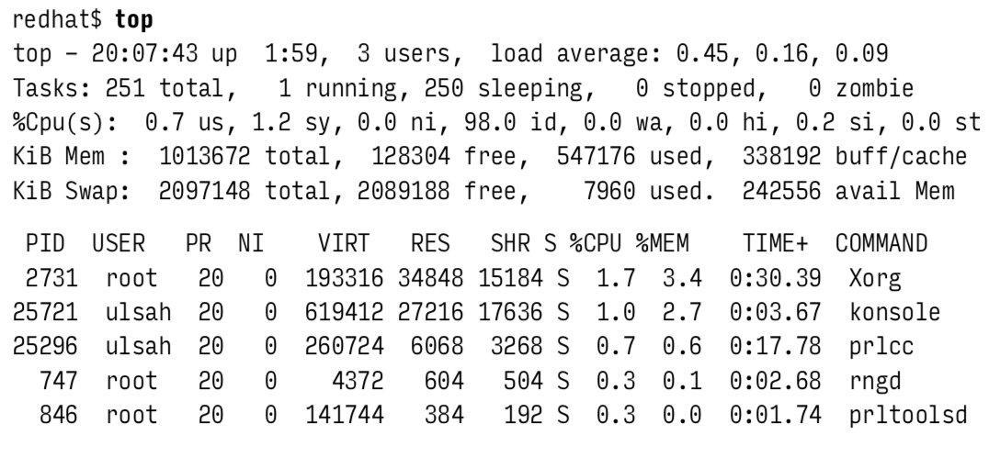
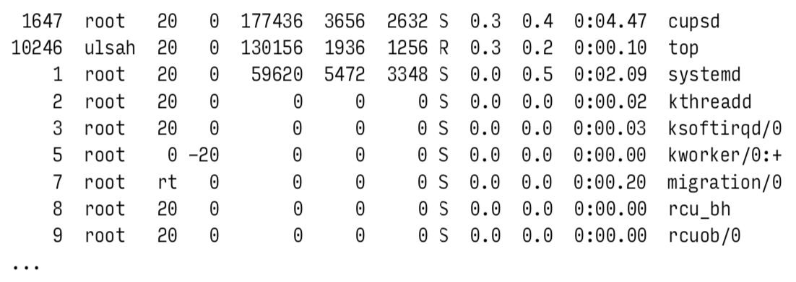

Slide 22
strace
Tool which allows you to view the execution of a process, usually used to diagnose root-causes of misbehaving processes
Optional package for Linux, so may need to be installed before use
Allows you to attach to a process, shows all the processes system calls, and then detach from the process “without disturbing it”
System calls are low level, but strace shows parameters used in the system calls as well as the kernels response
Look for error codes (which strace will often decode for you) first
Notes:
There can be some issues when attaching and detaching strace from a process causing system calls to be interrupted

Slide 23
Questions?

Slide 24
Additional Resources
TLDP Chapter 4: Processes

